Slide 1
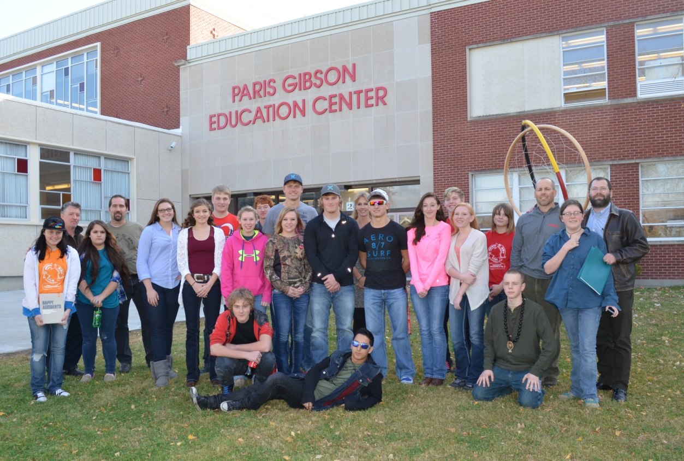

The Paris Produce Project

Slide 2
1. Art & Lynx Grafix 2. Auto Shop & Welding 3. Culinary Arts 4. Math 5. One Montana 6. Science
Classes & Programs

Slide 3
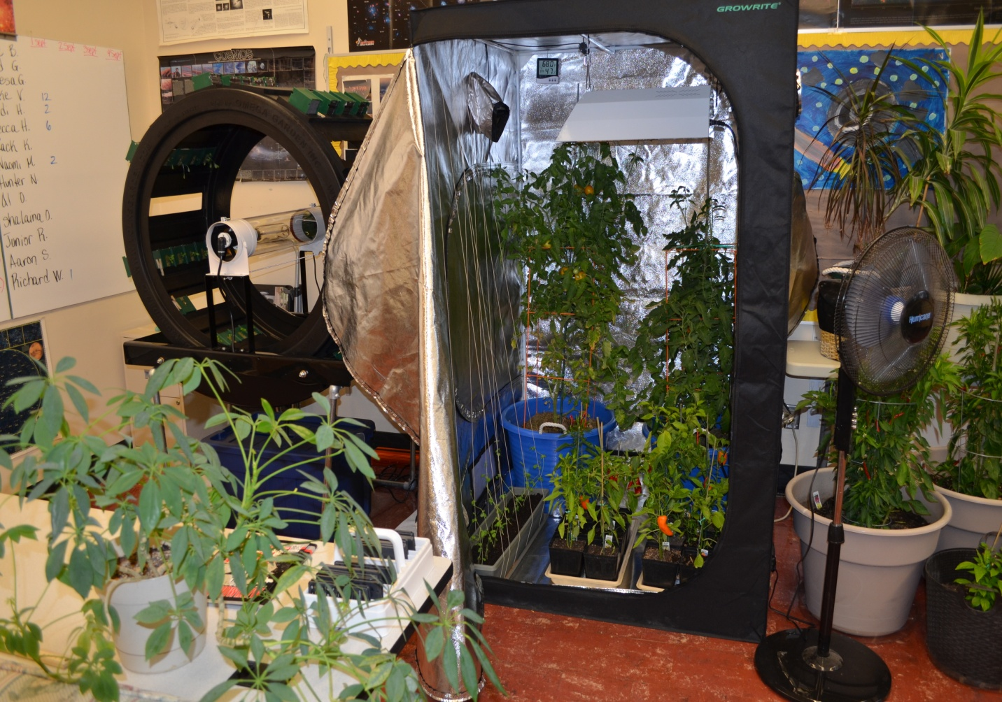
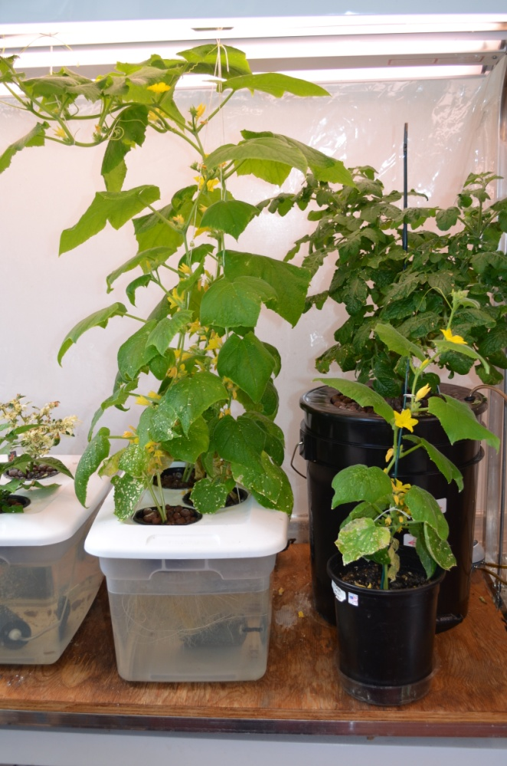
PGEC Growing Systems
We are growing vegetables (mostly peppers) using hydroponics, aquaponics as well as traditional soil.
Notes:
kristian

Slide 4
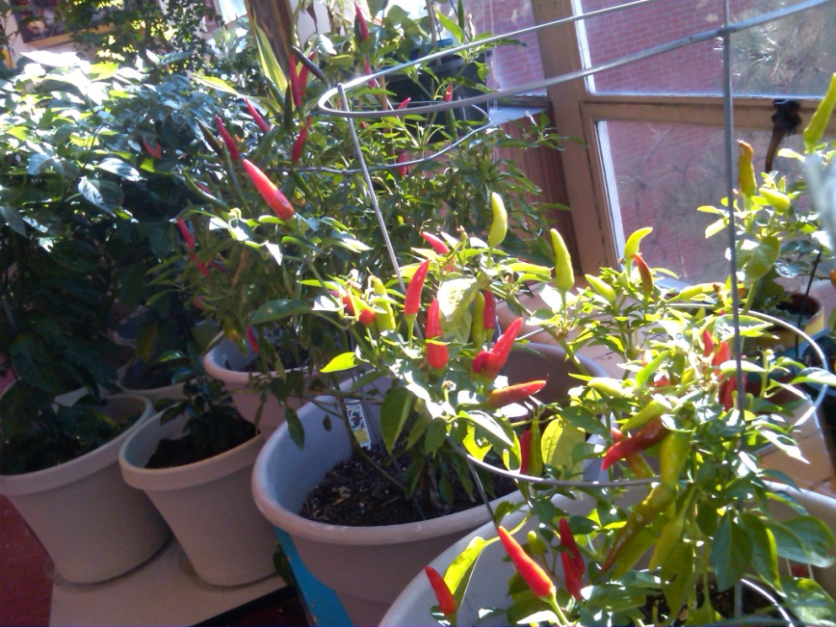
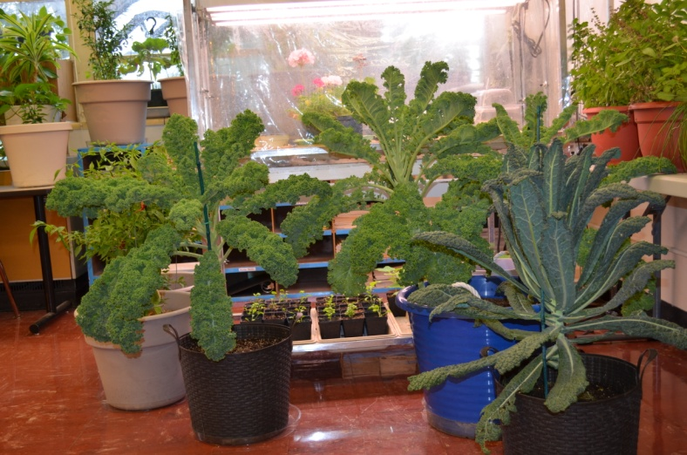
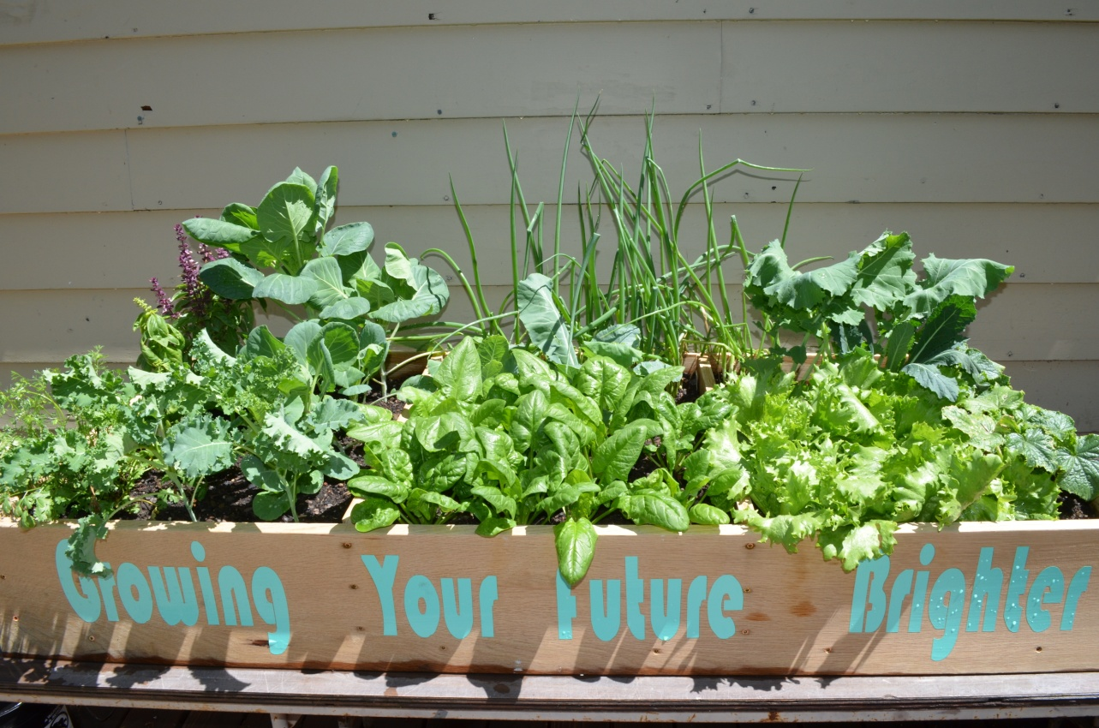
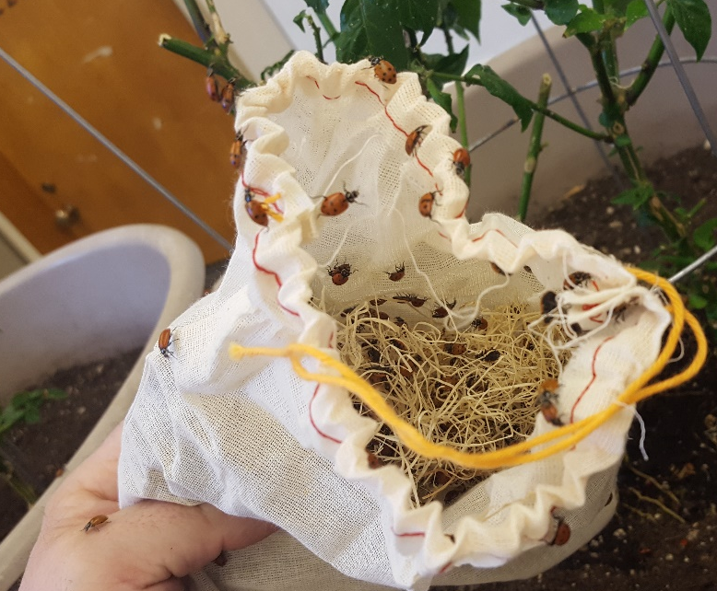
Soil System
Notes:
alex

Slide 5
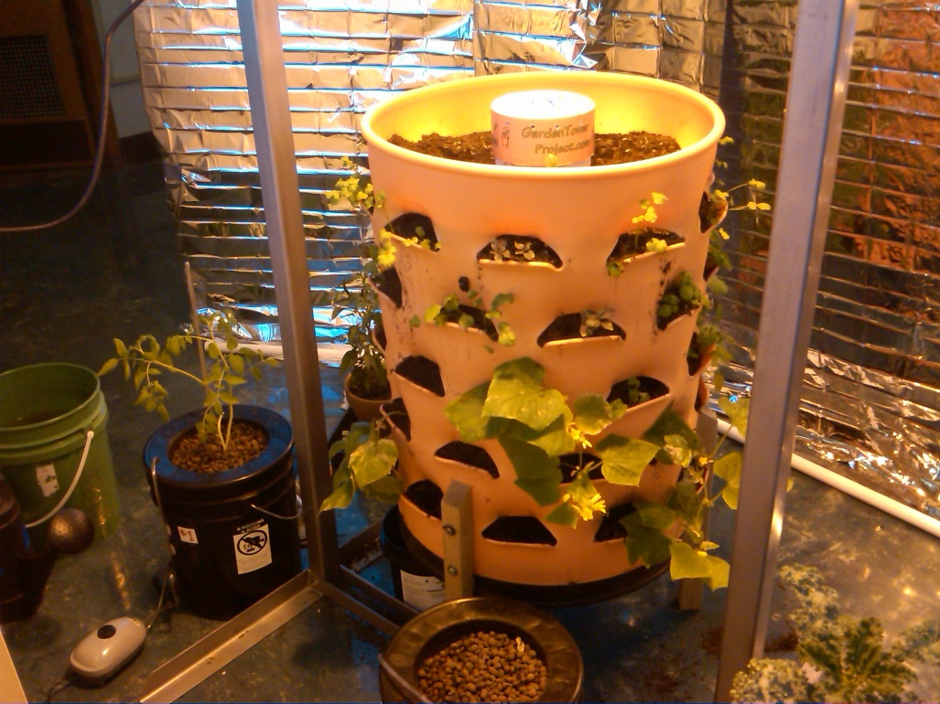
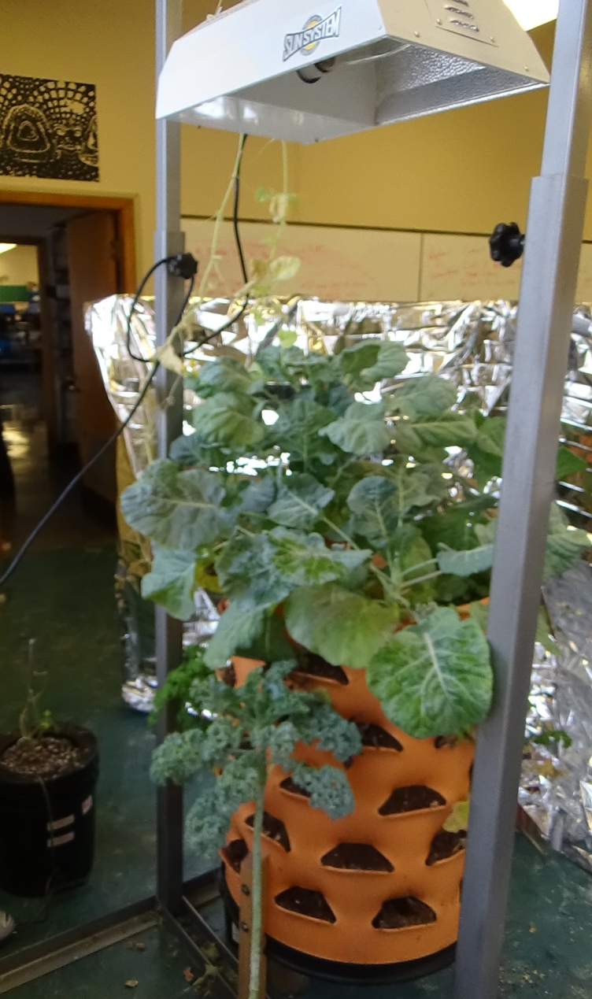
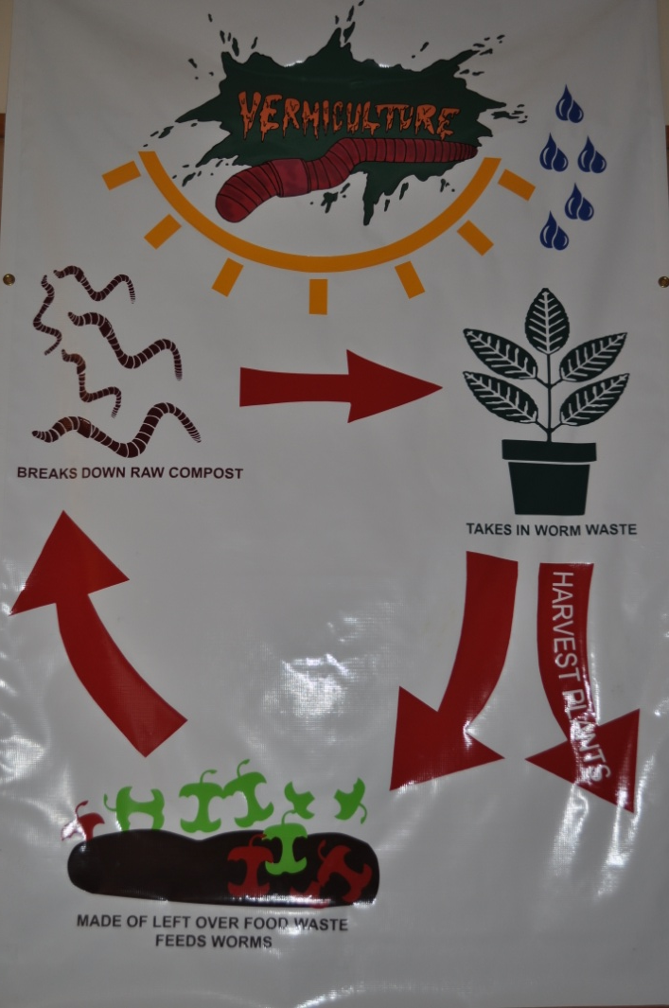
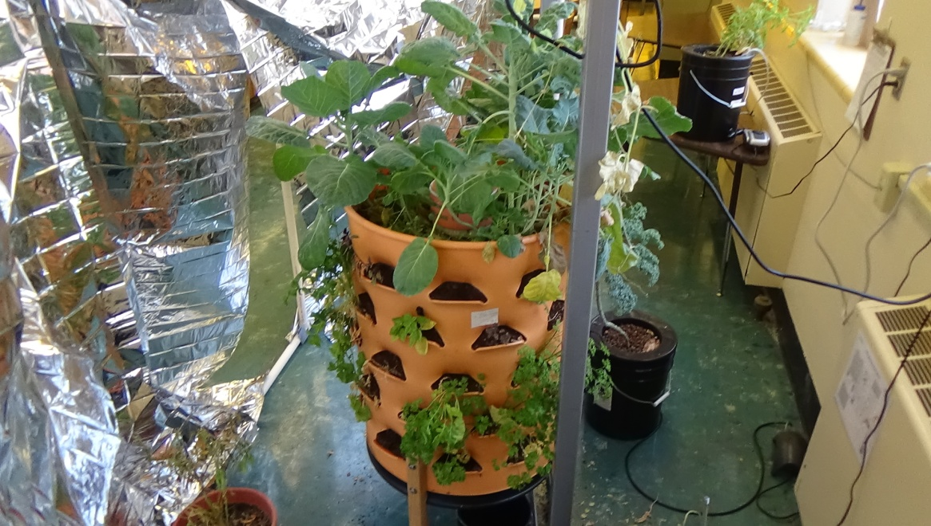
Vermiculture System
Notes:
alex

Slide 6
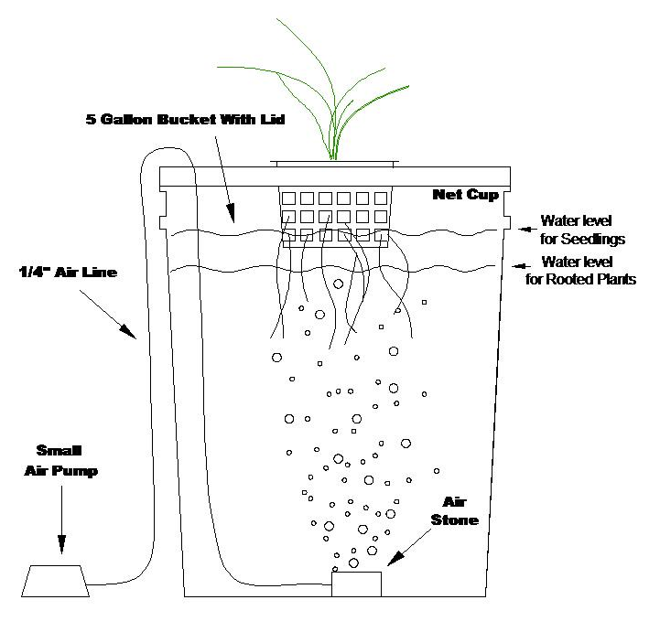
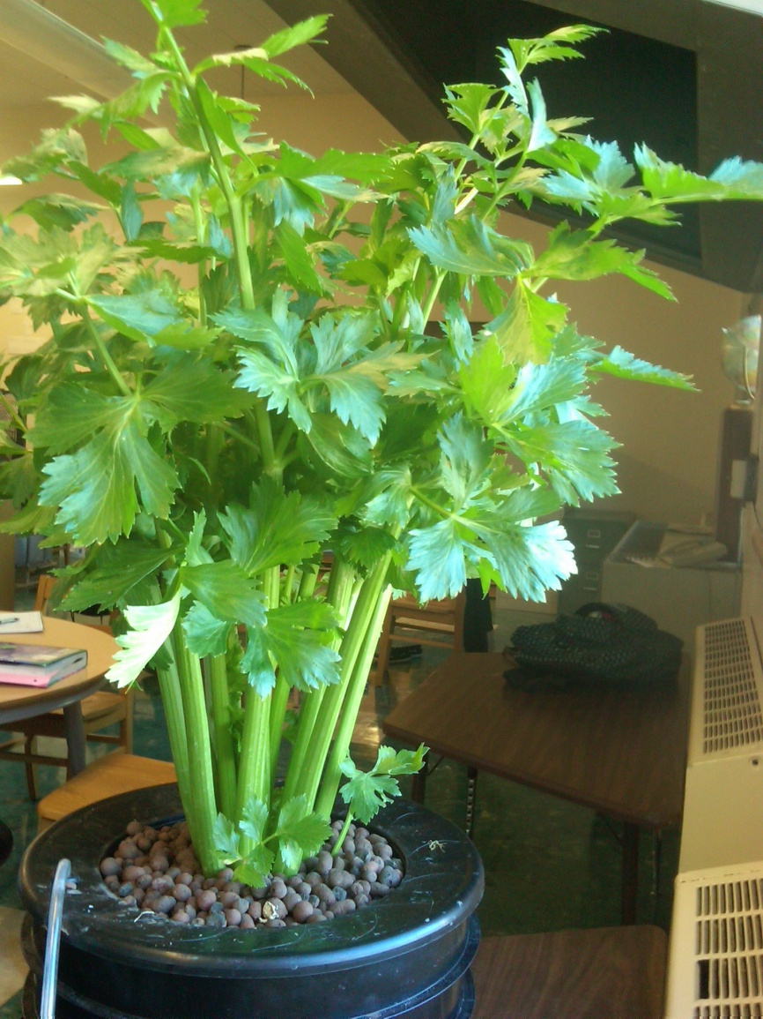
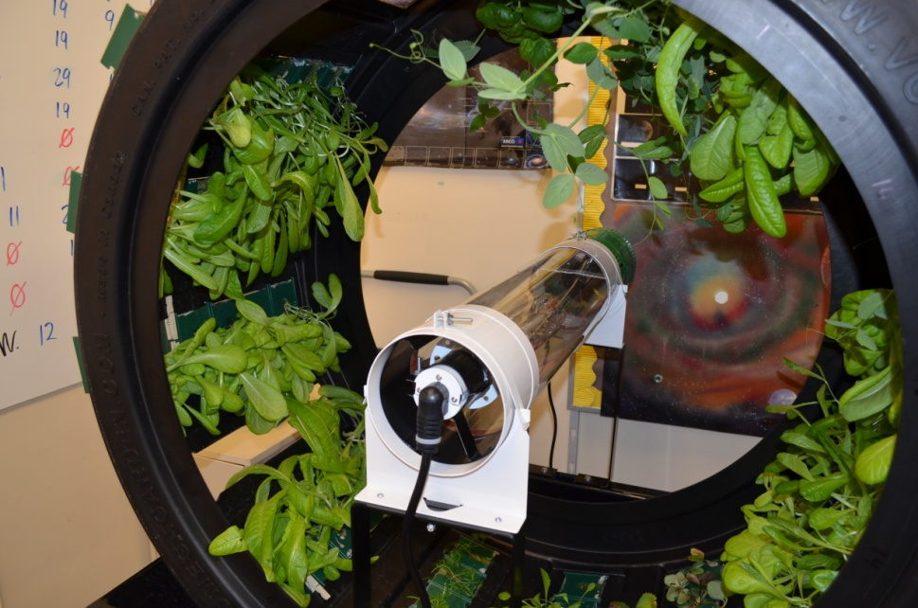
Hydroponic System
Notes:
alex

Slide 7
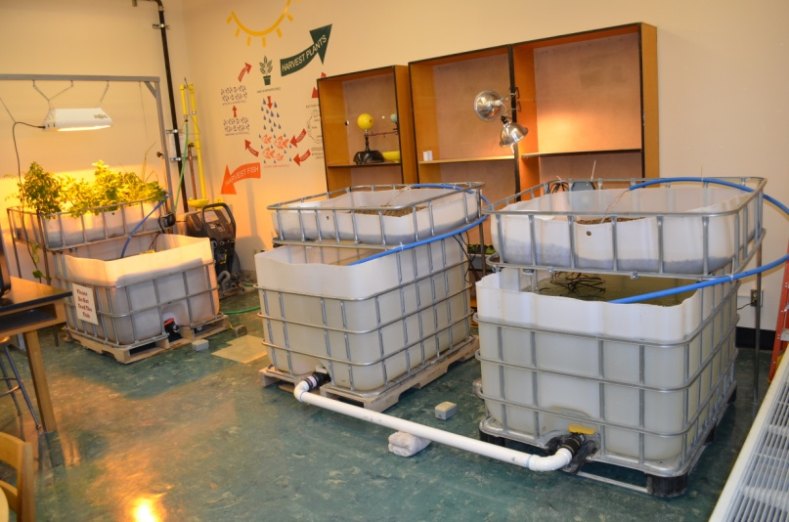
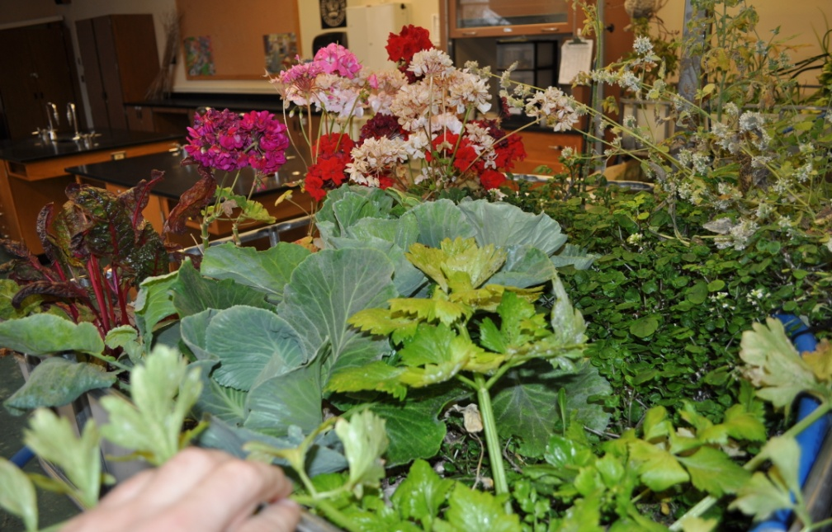
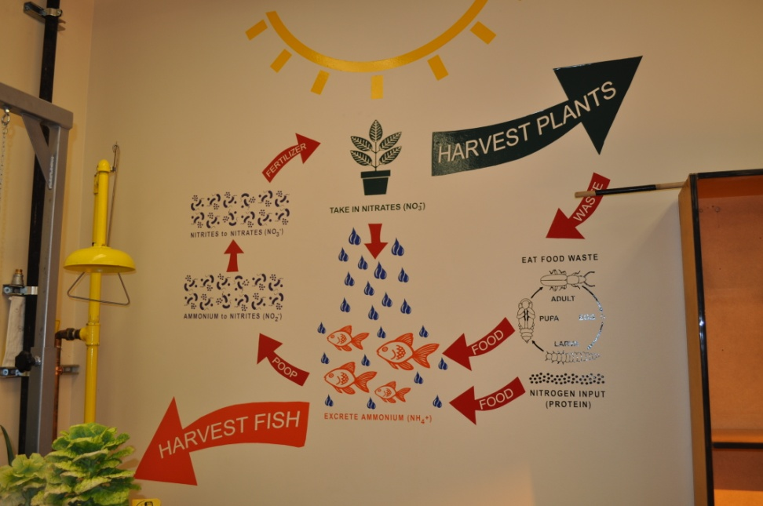
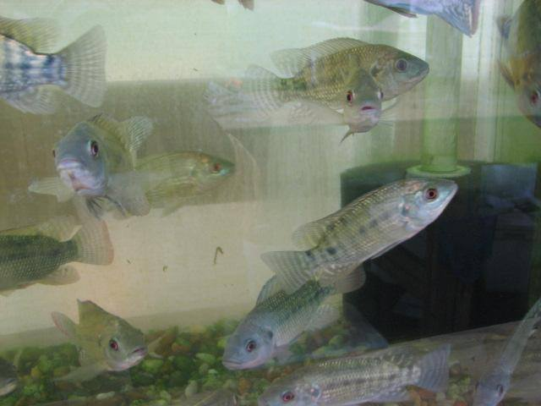
Aquaponic System
Notes:
alex

Slide 8
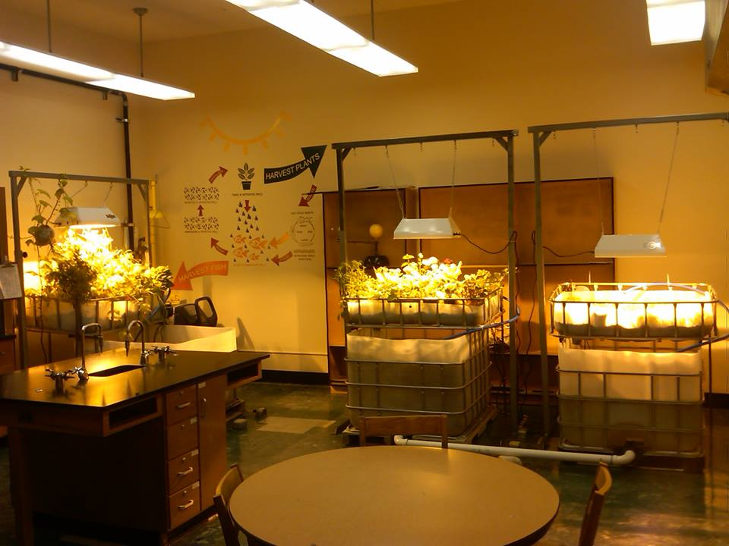

Slide 9
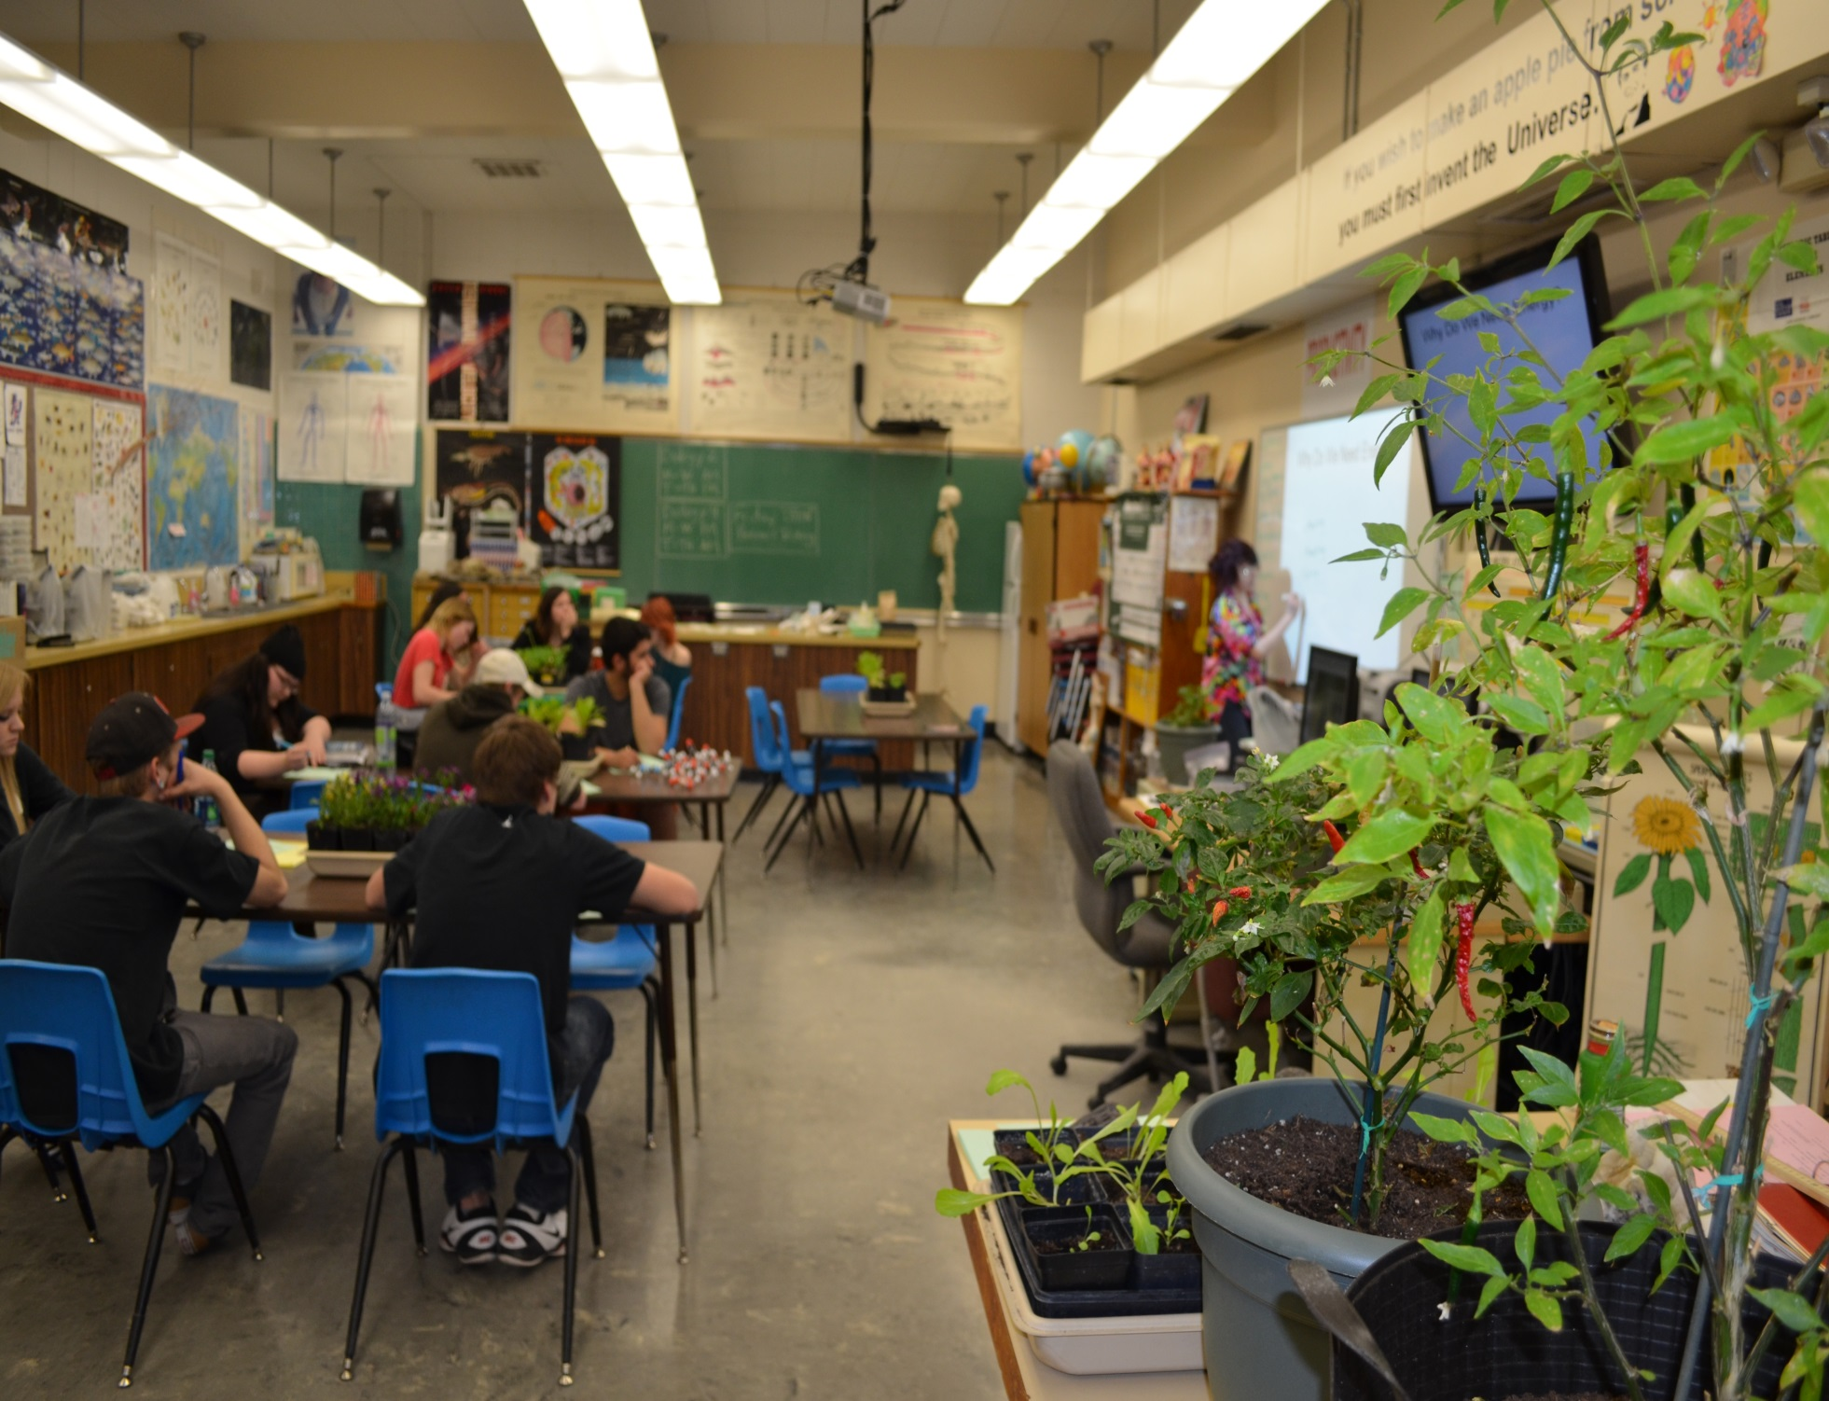
Gardening Class

Slide 10
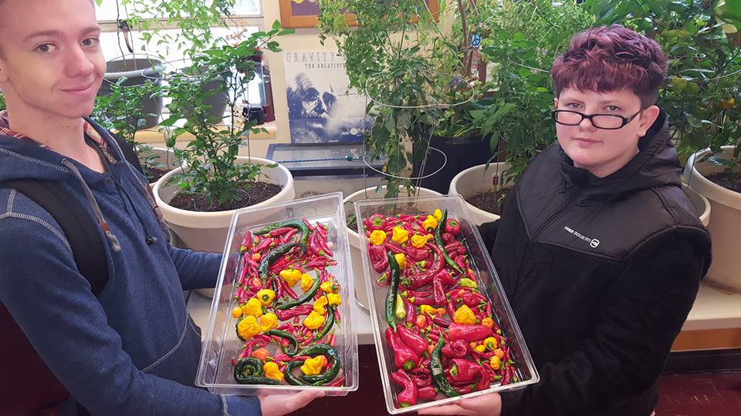
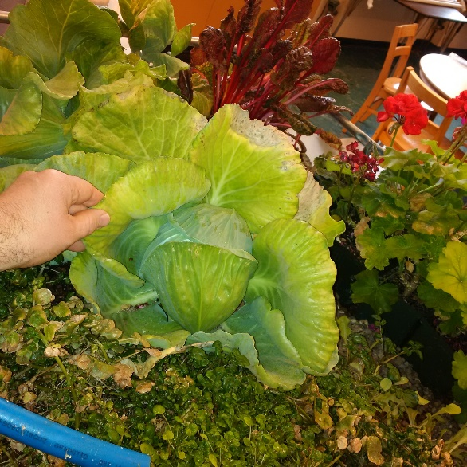
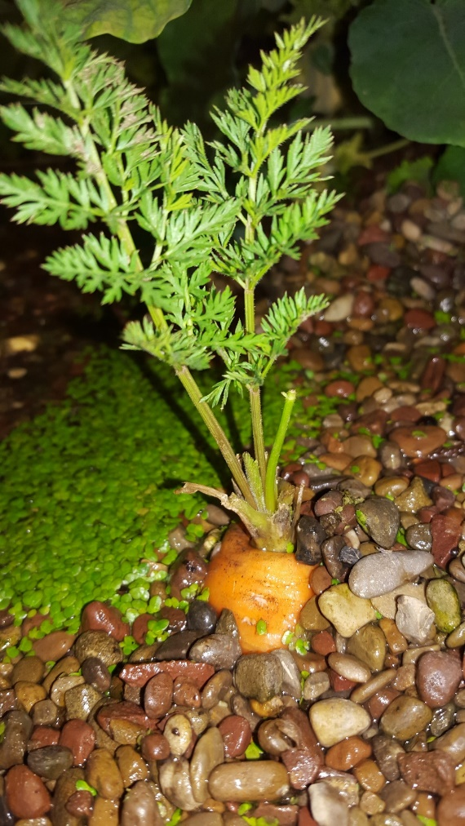
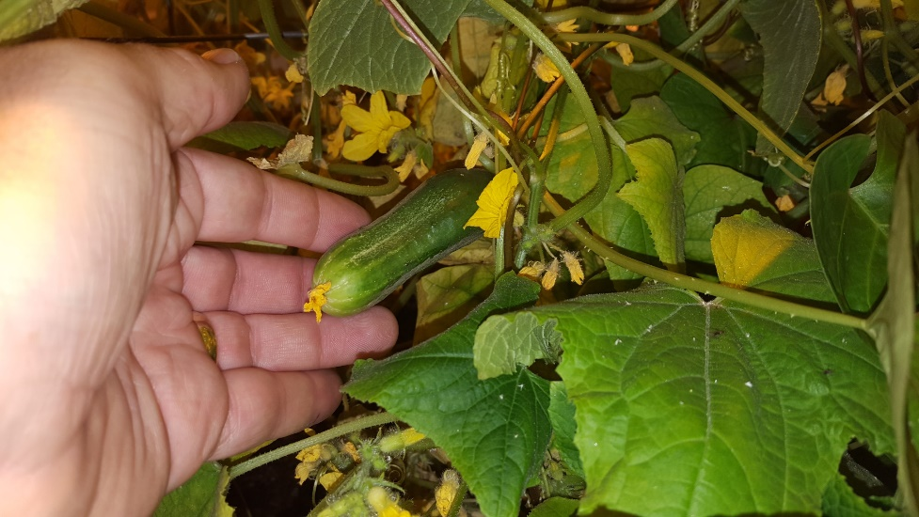
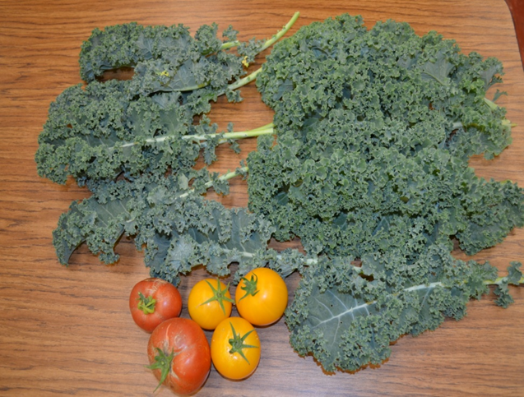
The Paris Produce Project
The culinary students prepare lunches using the produce that we grow.
Notes:
kristian

Slide 11
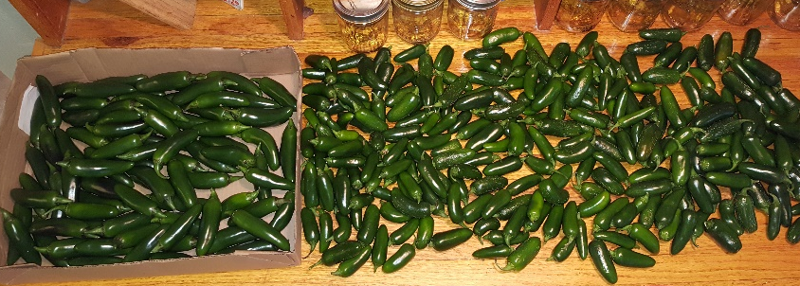
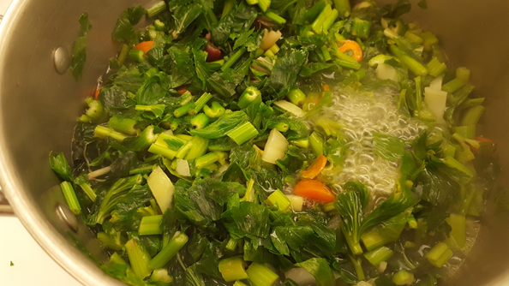
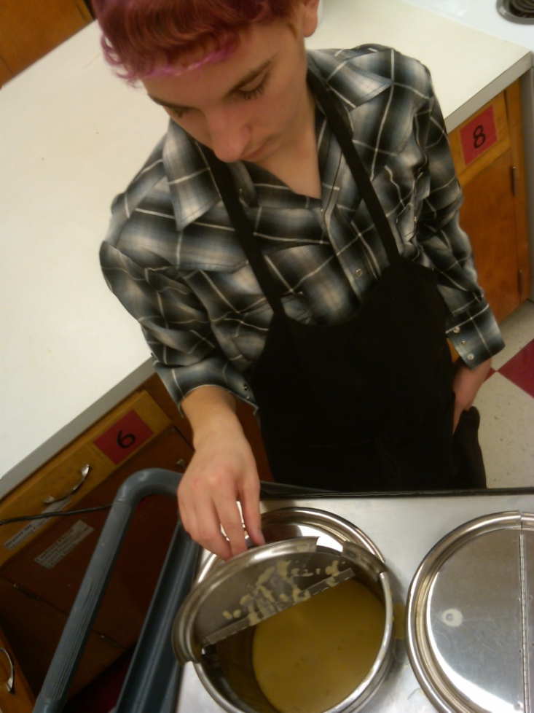
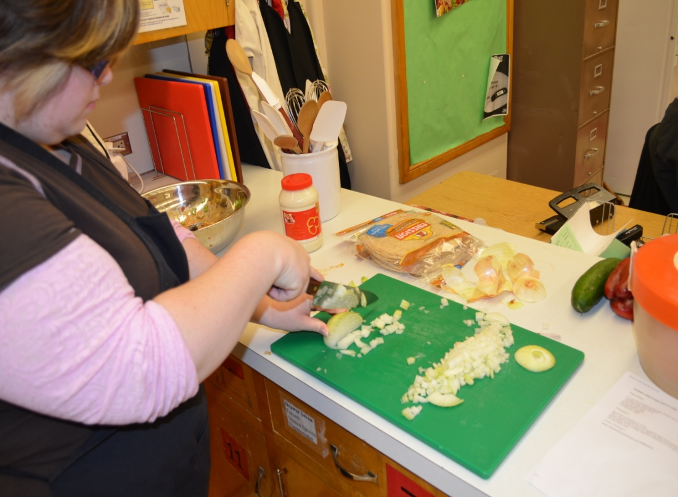
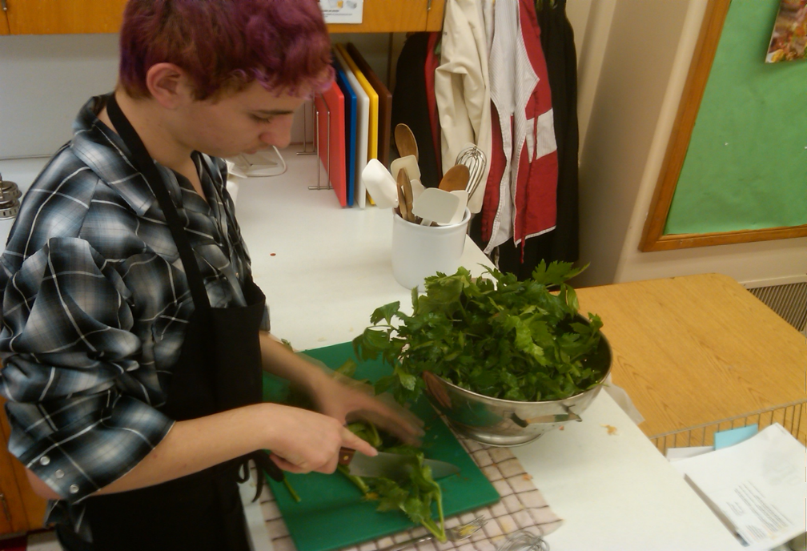
The Paris Produce Project
The culinary students prepare lunches using the produce that we grow.
Notes:
kristian

Slide 12
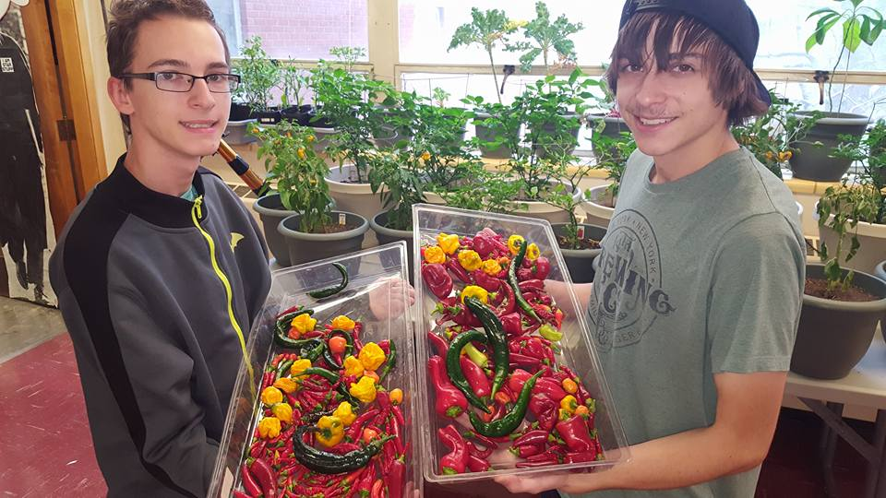
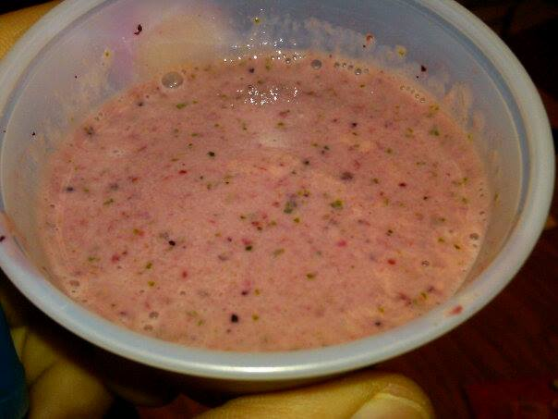
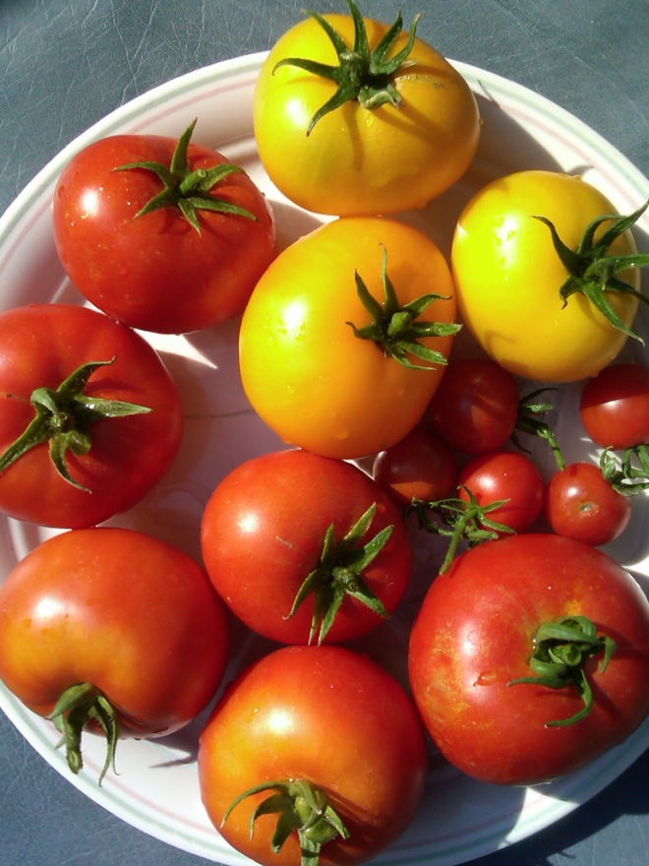
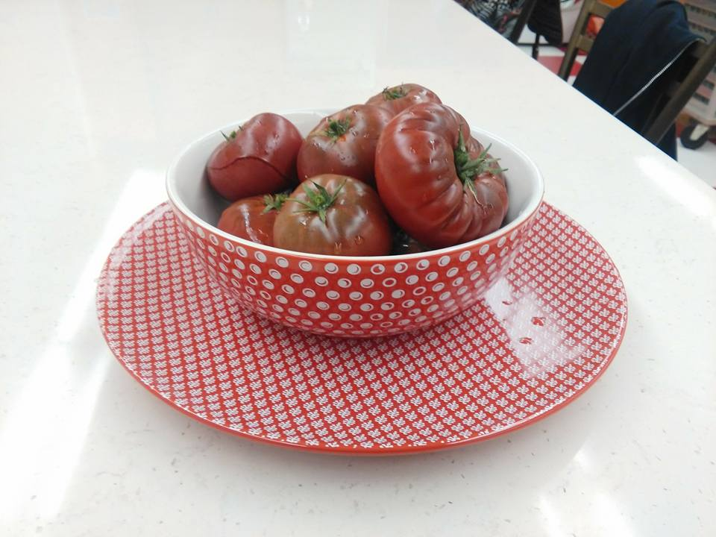
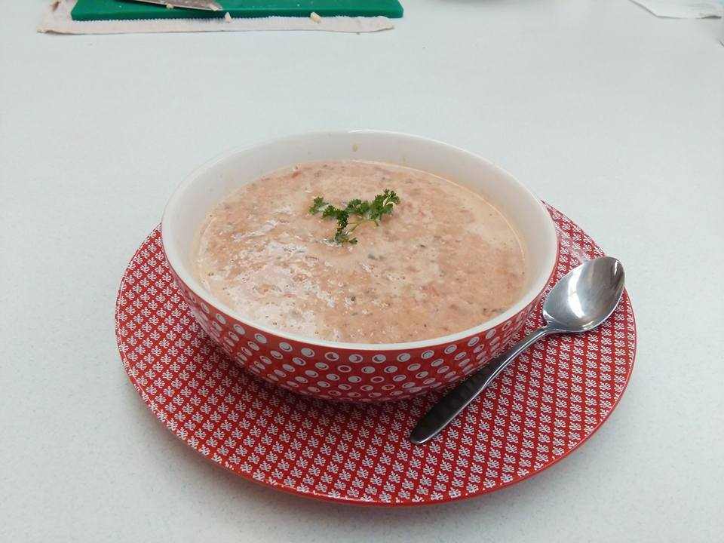
The Paris Produce Project
We are serving prepared foods in the Alternative everyday to give a healthier choice.
Notes:
kristian

Slide 13
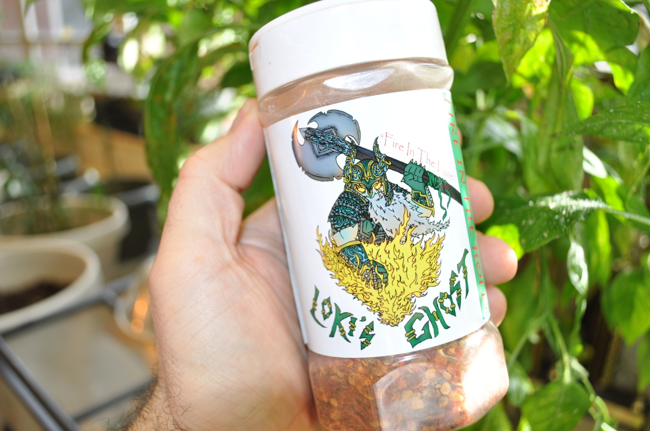
Loki’s Ghost Pepper Shake

Slide 14
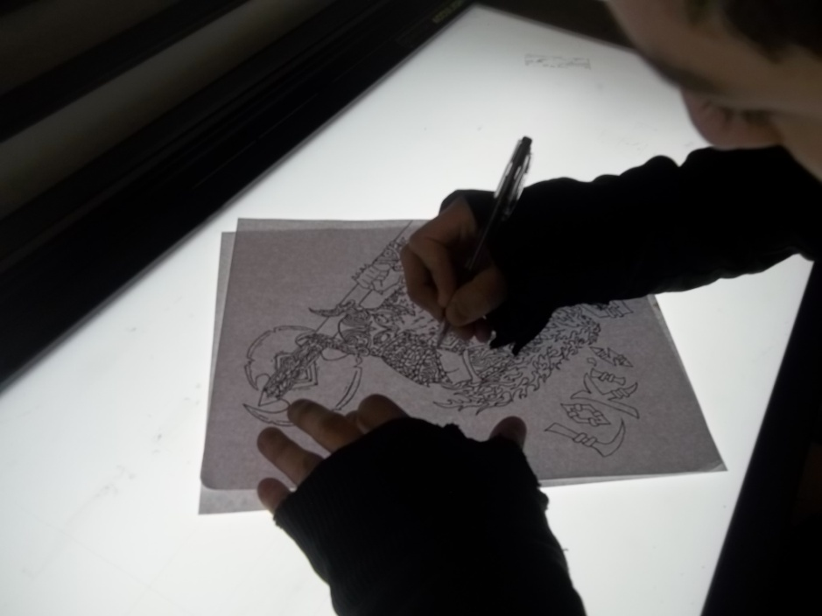
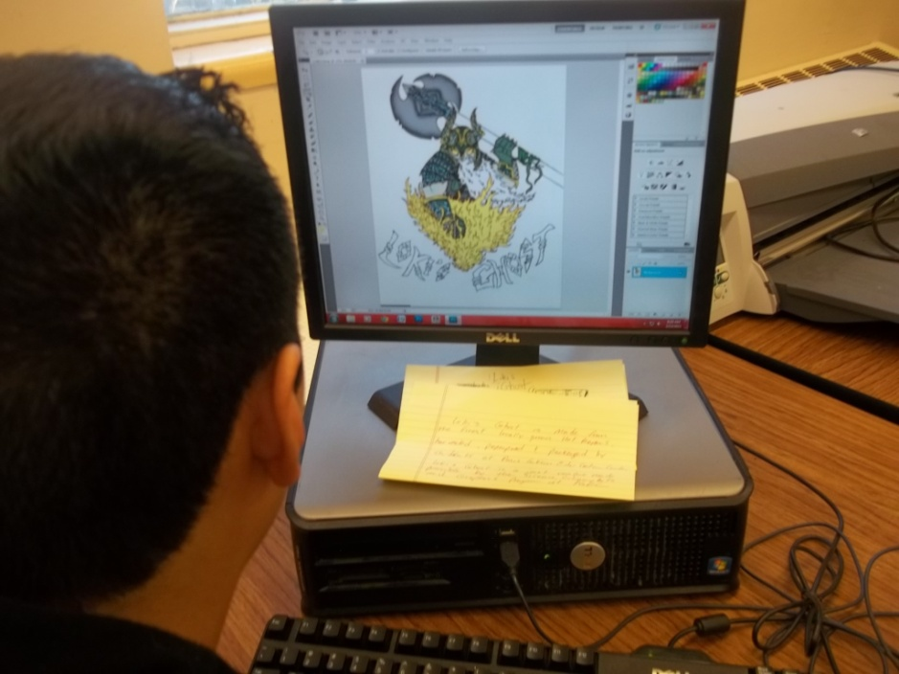
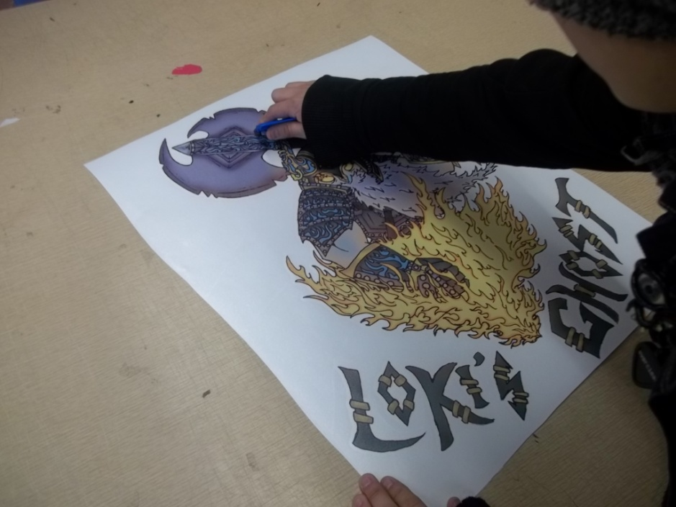
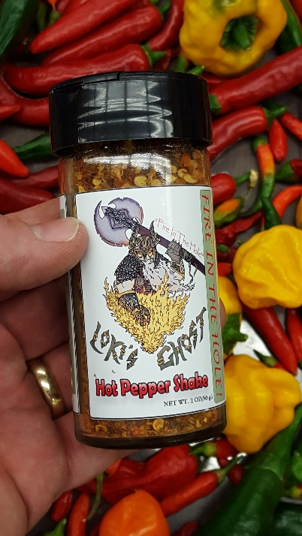
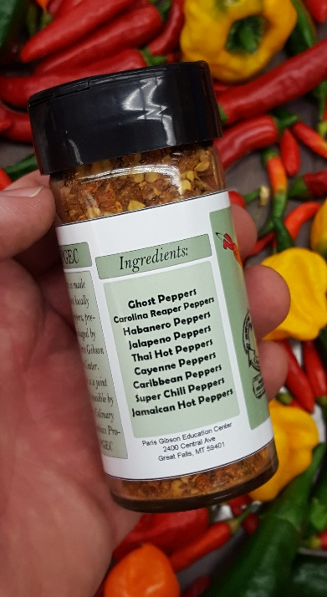
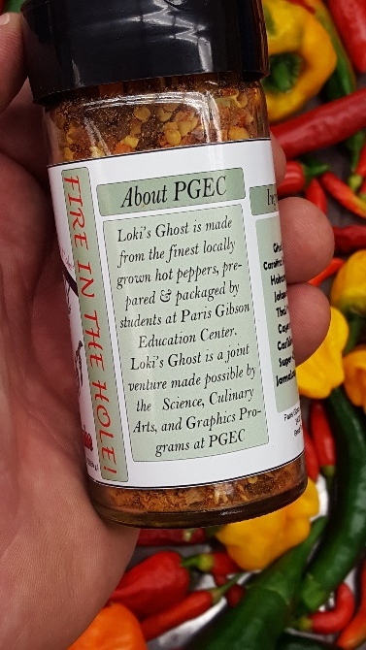
Loki’s Ghost Designed & Labeled

Slide 15
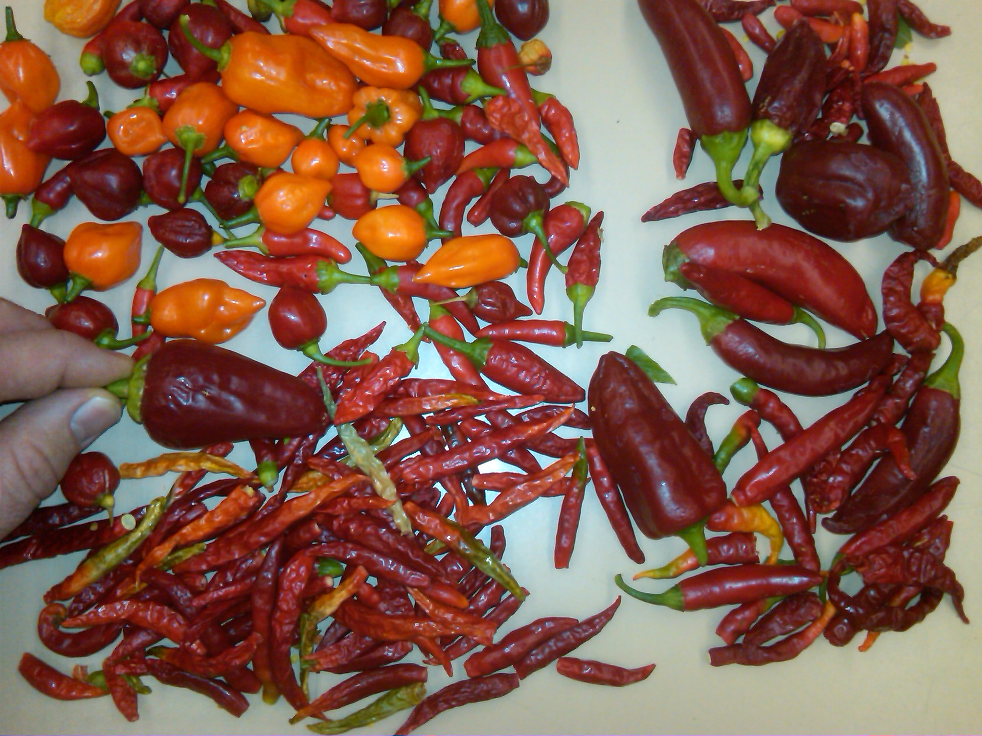
Loki’s Ghost School Grown

Slide 16
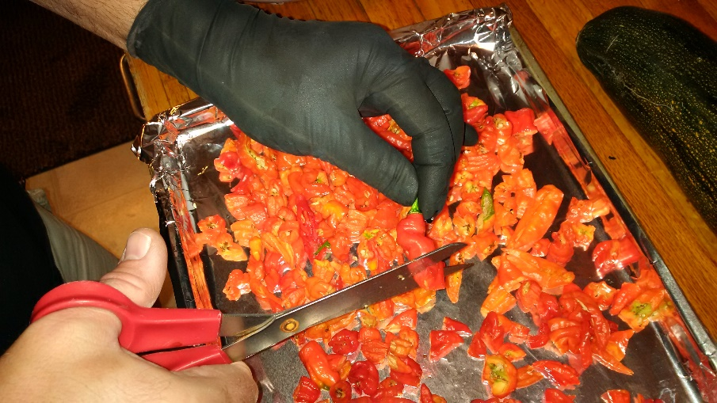
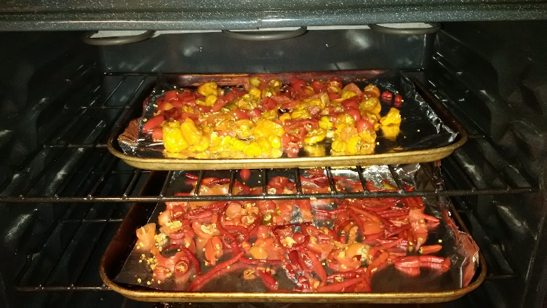
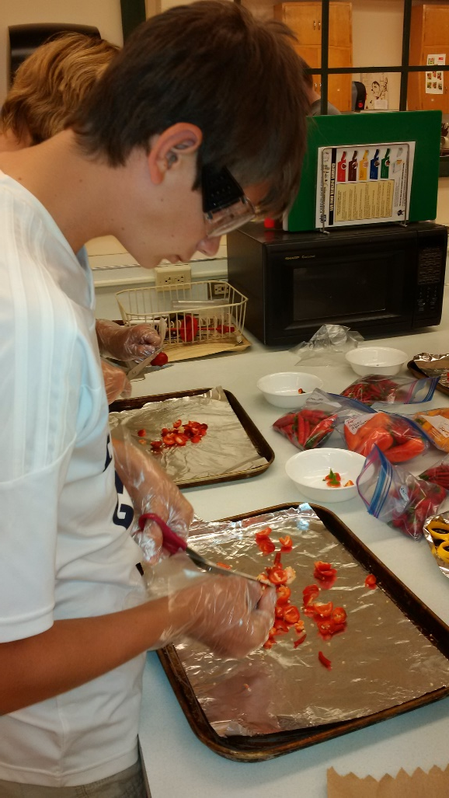
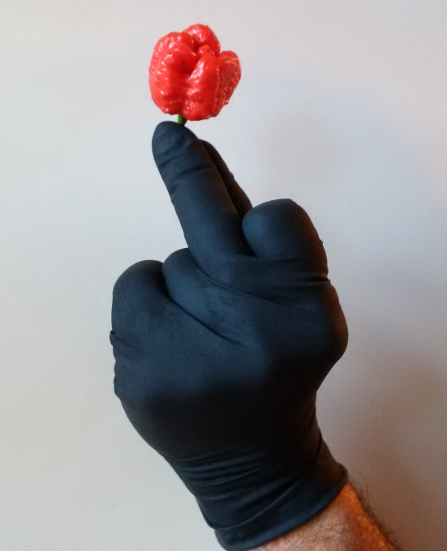
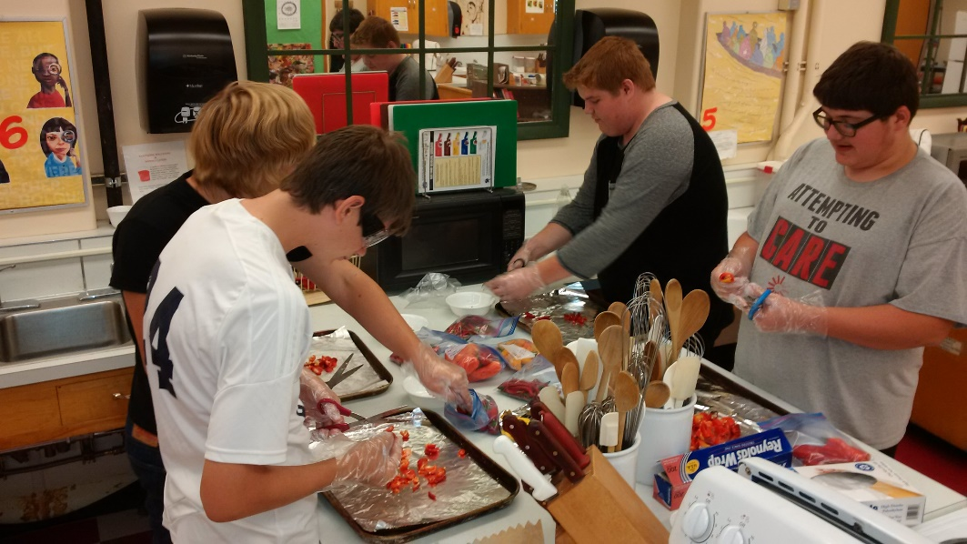
Loki’s Ghost Cut & Dried

Slide 17
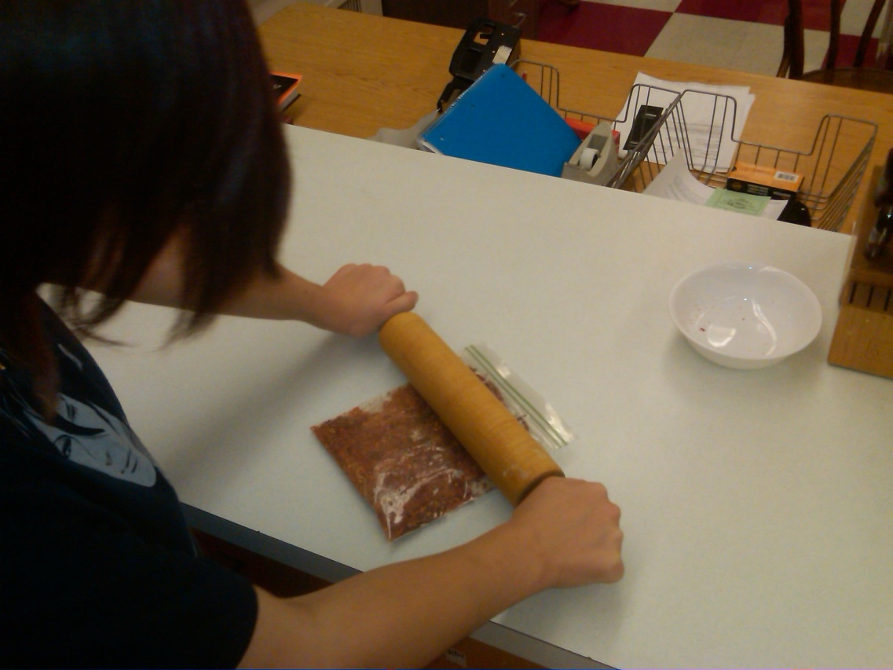
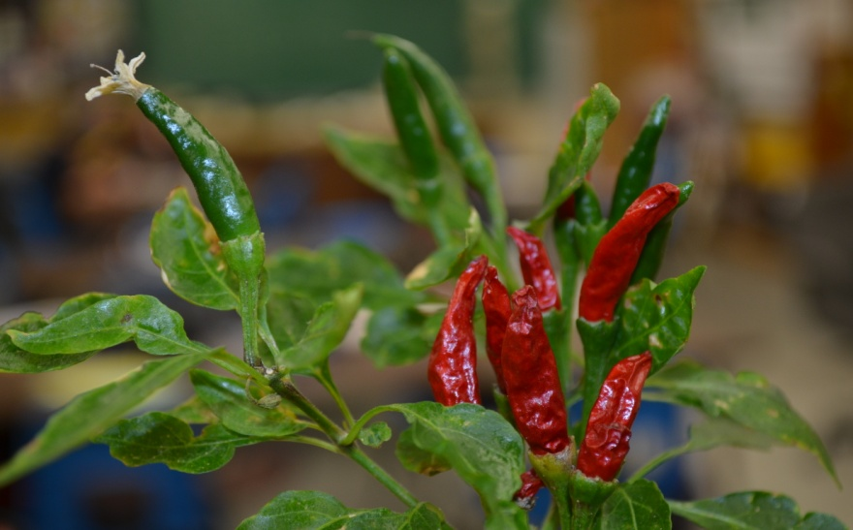


Loki’s Ghost Dried & Crushed

Slide 18





Loki’s Ghost Packaging

Slide 19
1. GF Police Dept. 2. Montana Grow Hydro 3. Jack’s Pets Store 4. The Flower Farm 5. Cascade Electric
Community Support From

Slide 20

Benefis Foundation Grant
We secured a $2,500 grant from the Benefis Foundation to allow this project to move forward.
Notes:
alex

Slide 21

2 GFPS Discovery Grants
We secured a $3000 and a $1700 grant from the Great Falls Public Schools Foundation to allow this project to move forward.
Notes:
alex

Slide 22

Sales of Loki’s Ghost
Each year we sell 100 bottles @ $15 each. We have generated over $2500 which is used to continue the grow project.
Notes:
alex

Slide 23
1. Grow room 2. Aquaponics 3. Lynx Graphics 4. Culinary Arts 5. Alternative Café
Lets Follow the…
“Path of the Pepper”

